Slide 1


Slide 2
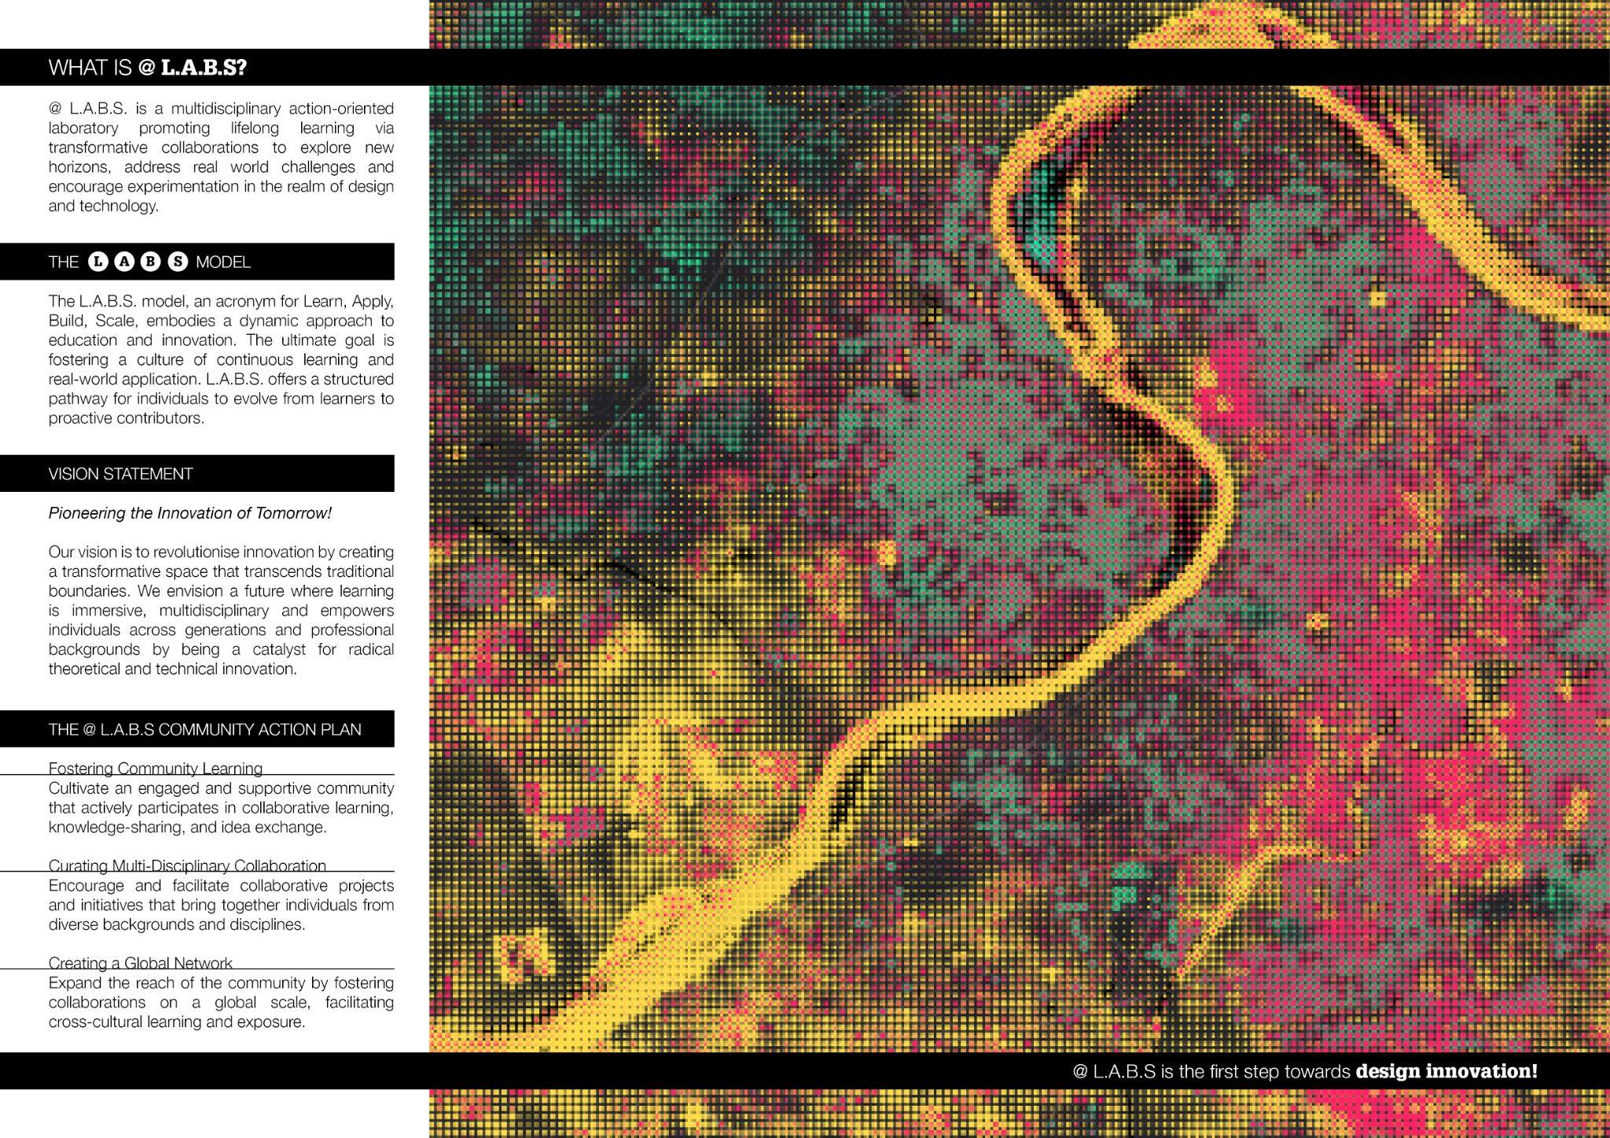

Slide 3

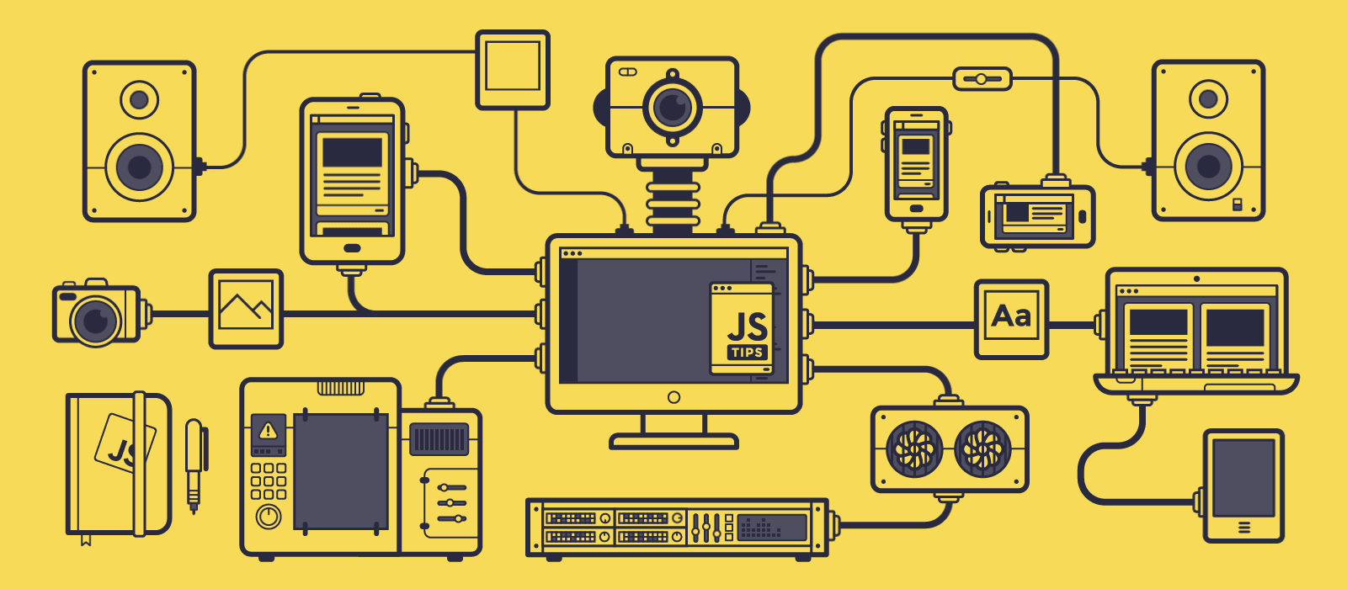

Slide 4
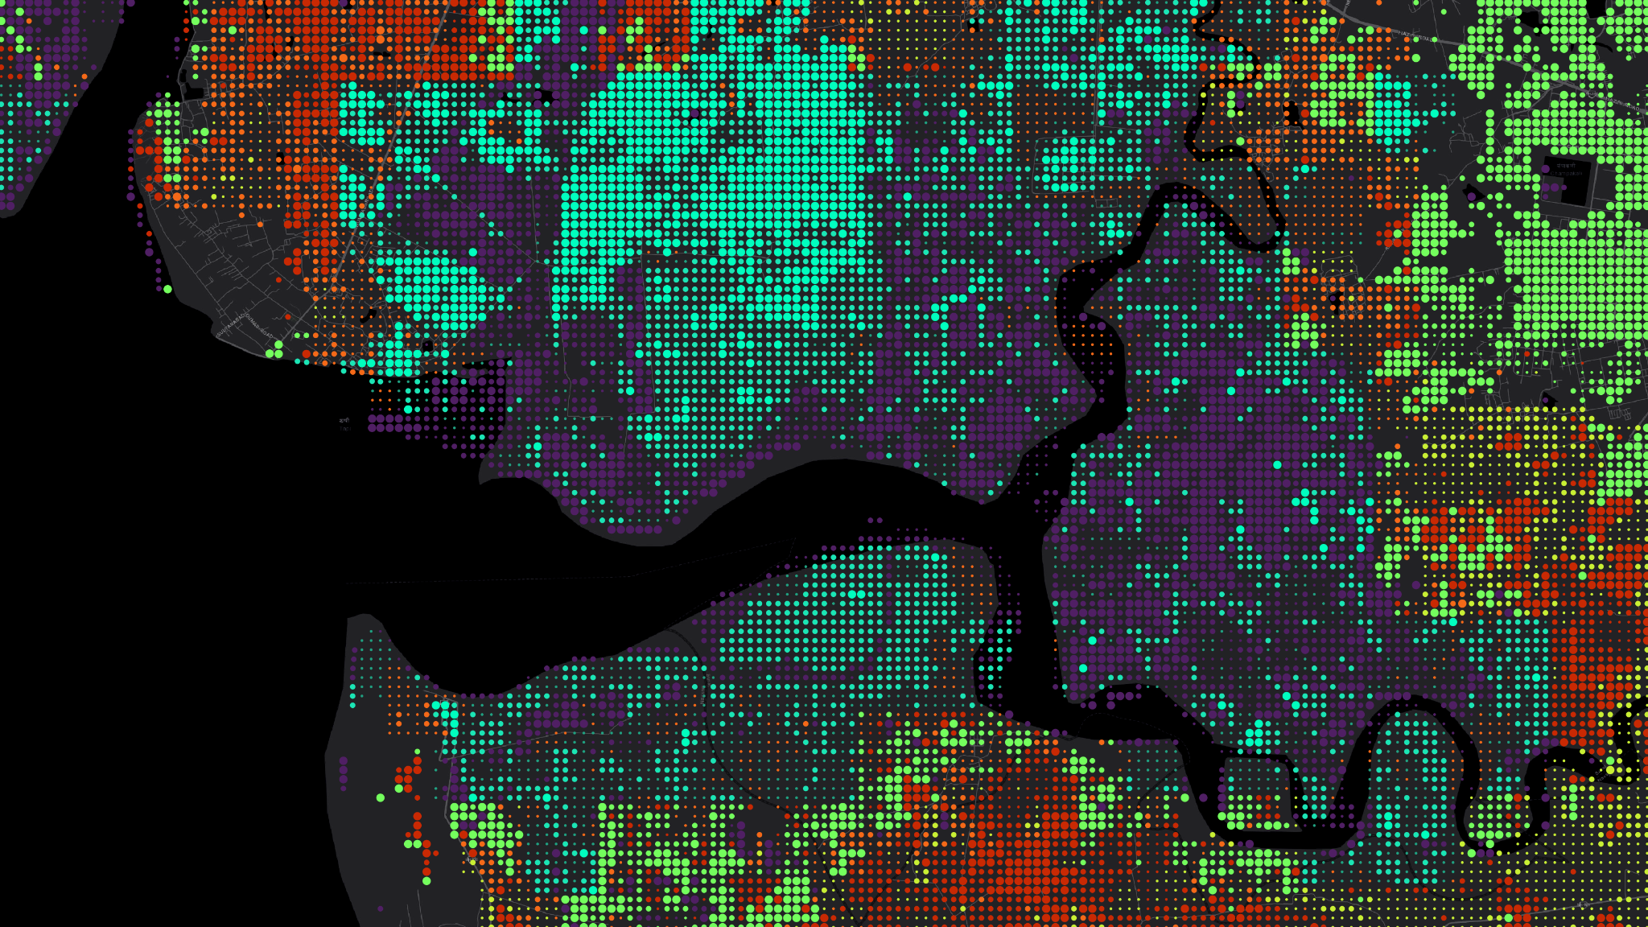
CITY.AI

Slide 5
CONTENTS
LEARN
L1: AI, Cities and Open Data Banks
L2: Machine Learning
L3: Satellite mapping and data processing

Slide 6
CONTENTS
LEARN
L1: AI, Cities and Open Data Banks
L2: Machine Learning
L3: Satellite mapping and data processing

Slide 7
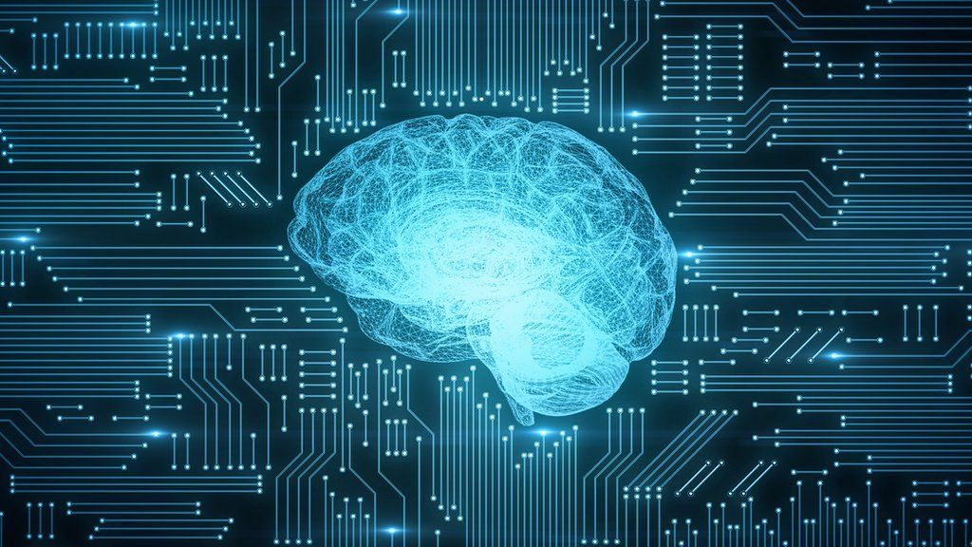
What is
AI

Slide 8
DEFINITION
AI
“ An entity that empowers machines to Learn, Think, and Reason “

Slide 9



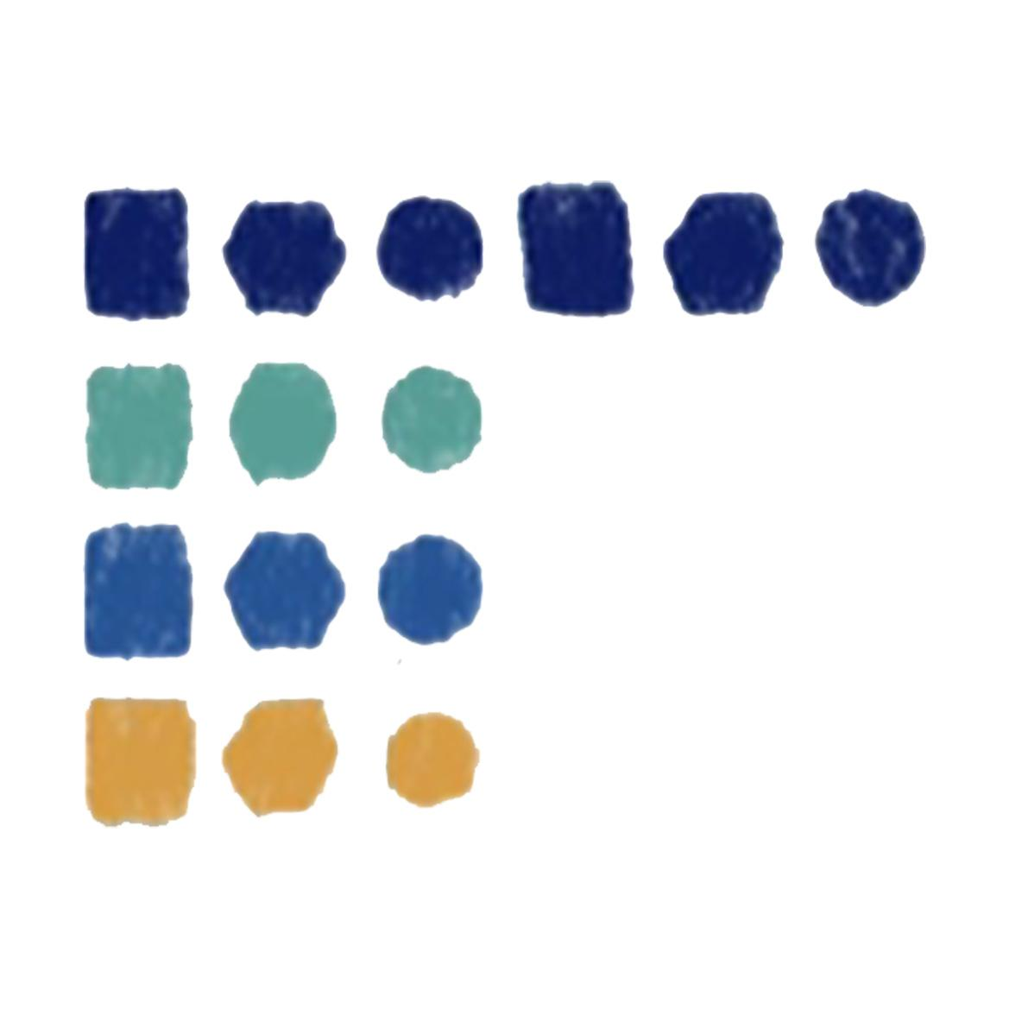
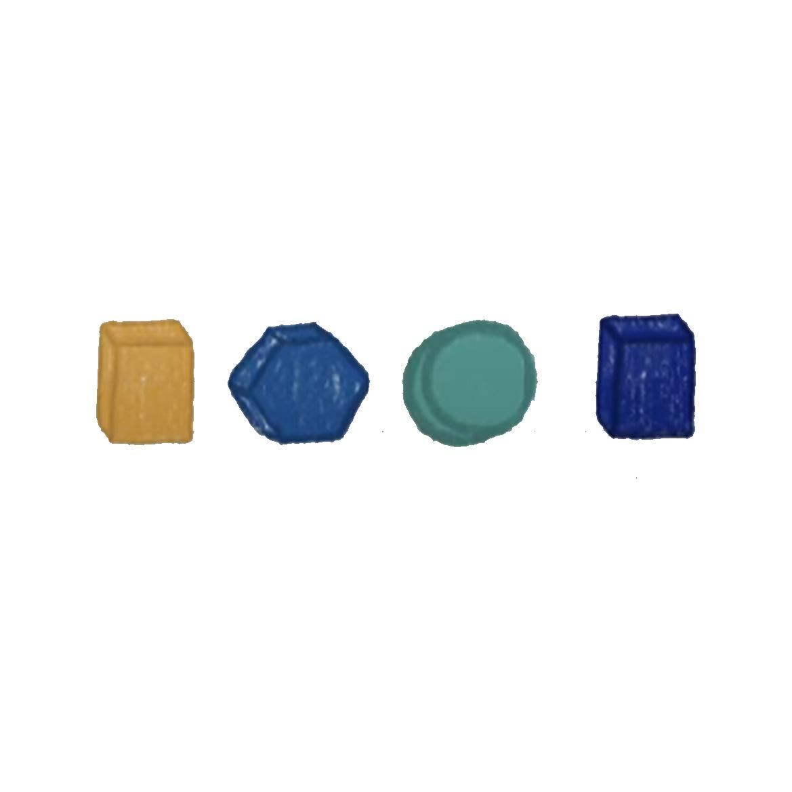
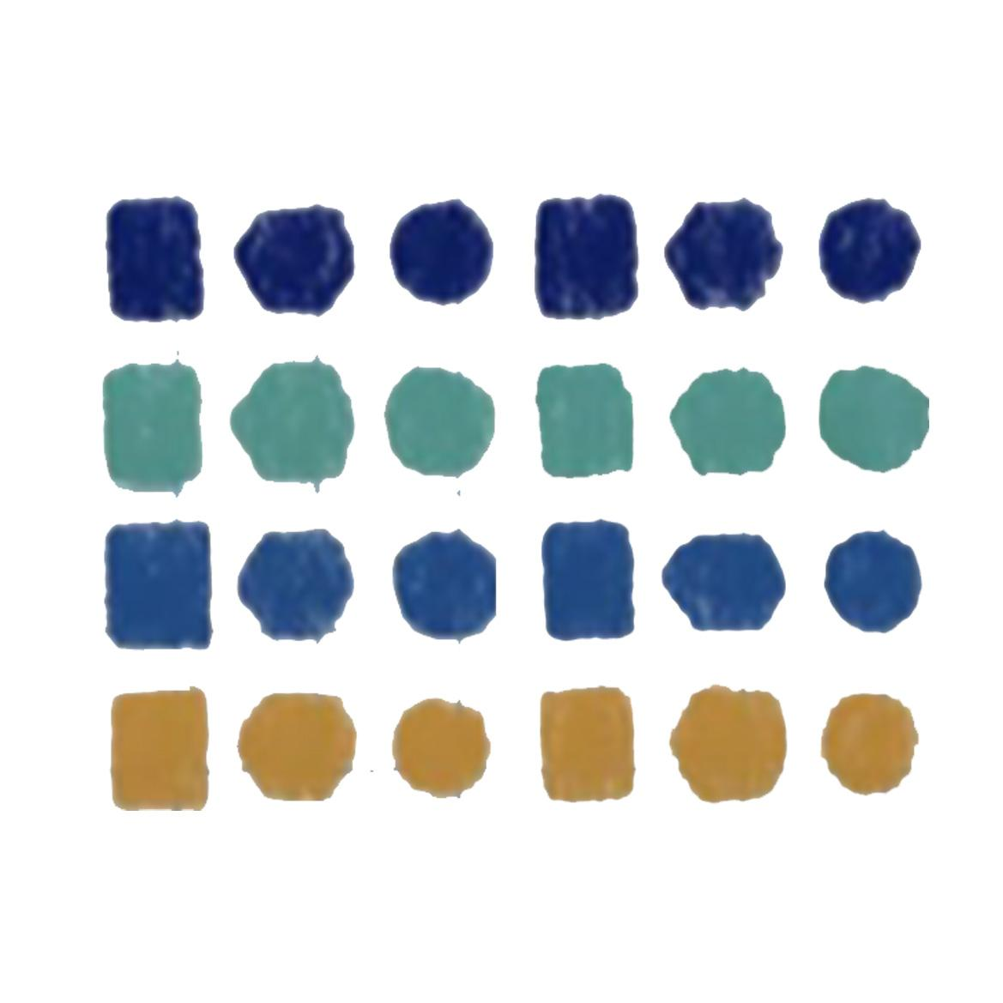
HOW DOES IT WORK
Sort
DATA
Patterns
Recommend
DATA
Predict
Black Box

Slide 10
HOW DOES IT WORK
Sort
DATA
Patterns
Recommend
DATA
Predict
Black Box

Slide 11
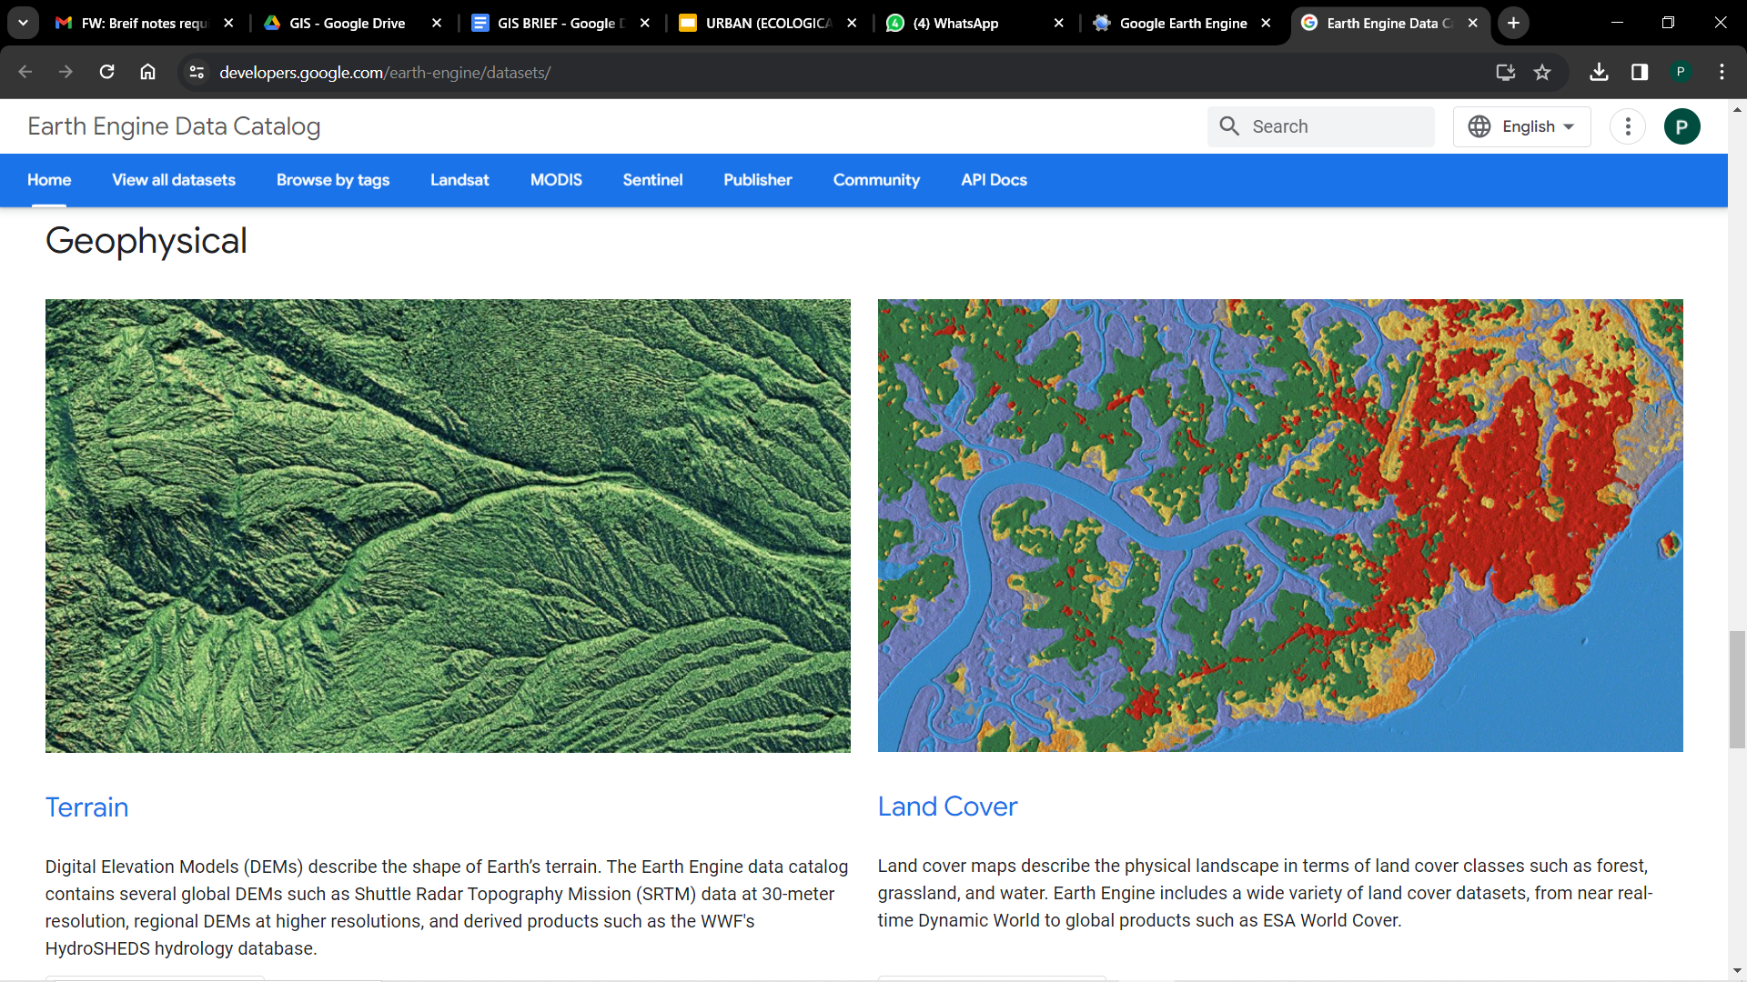




DATA SOURCES
Google Earth Engine
Data.Gov
Open Street Map
Google Maps
Amplifi
https://earthengine.google.com/
https://data.gov.in/
https://www.openstreetmap.org/
https://www.google.com/maps
https://amplifi.mohua.gov.in/

Slide 12
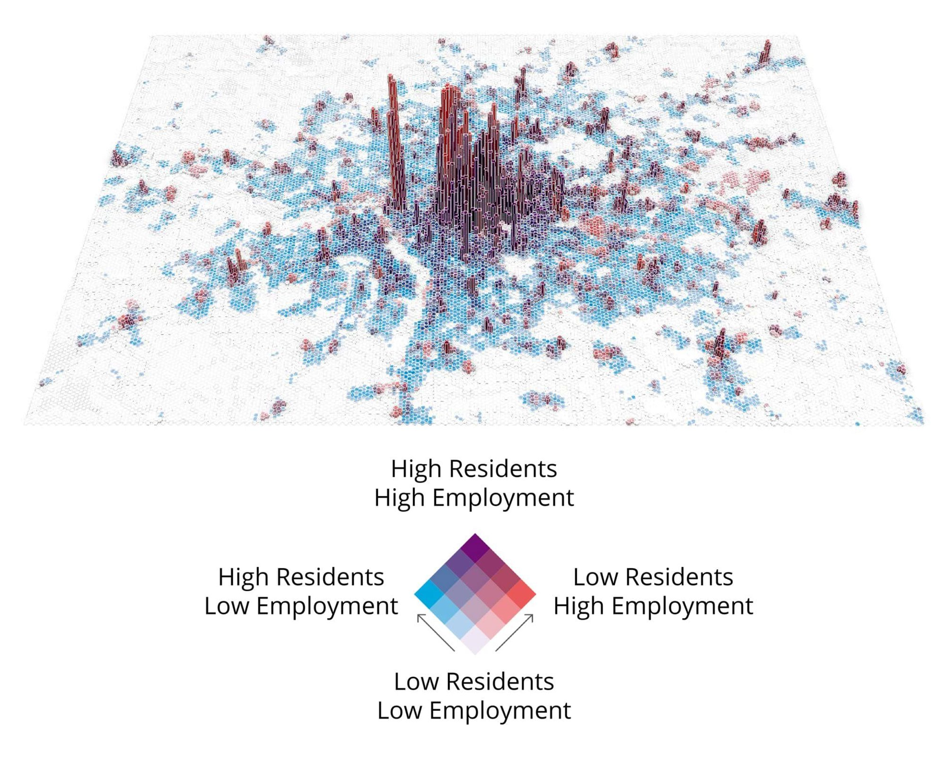
URBAN DATA ANALYTICS
THE SCIENCE OF URBAN FORM: DATA-DRIVEN SOLUTIONS TO REAL-WORLD PROBLEMS The Urban Design Group at Foster + Partners

Slide 13
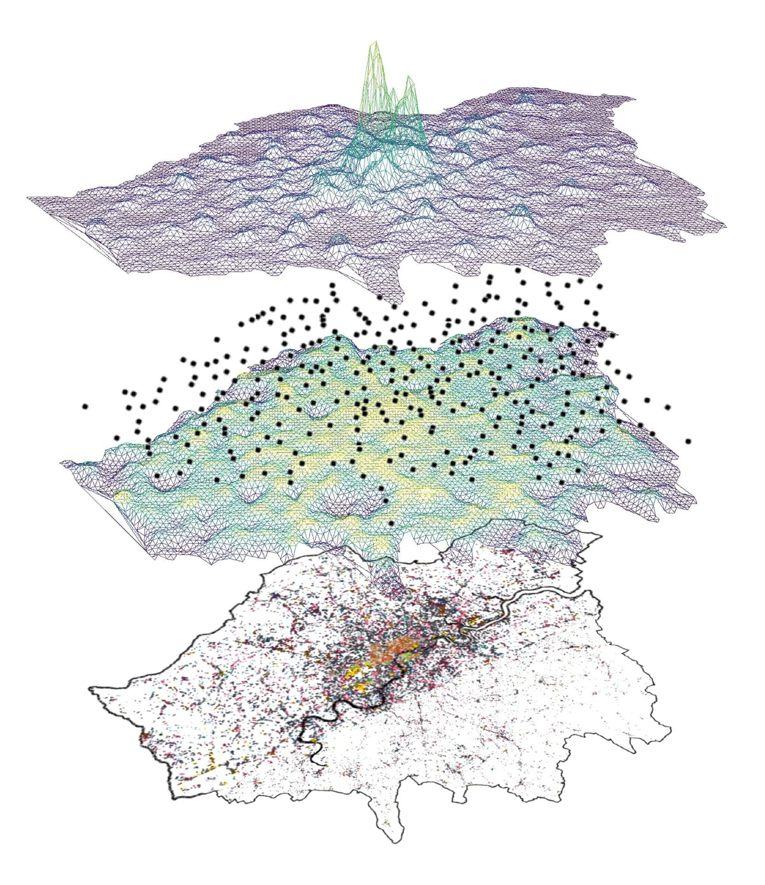
URBAN DATA ANALYTICS
Density of Amenities
Points of Interest
Proximity to Amenities
Base Map
THE SCIENCE OF URBAN FORM: DATA-DRIVEN SOLUTIONS TO REAL-WORLD PROBLEMS The Urban Design Group at Foster + Partners

Slide 14
LEARN
L1: AI, Cities and Open Data Banks
L2: Machine Learning
L3: Satellite Mapping and data processing

Slide 15
AI
Sort
DATA
Patterns
Recommend
DATA
Predict

Slide 16
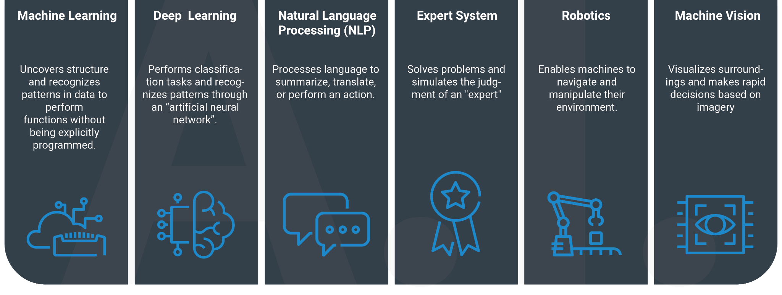
TYPES OF AI

Slide 17
TYPES OF AI
Personalized recommendations
&
Siri, Alexa
Voice Assistance
For Siri, Alexa
Chatbots Customer service
Personal Finance apps
Robotic vacuum cleaner
Facial Recognition

Slide 18
TYPES OF AI

Slide 19
MACHINE LEARNING
Unsupervised Learning
Unsupervised Learning
Supervised Learning
Unsupervised Learning
Reinforcement Learning

Slide 20
MACHINE LEARNING
support vector machines
self-organising maps
neural networks
Decision
trees
boltzmann machines
Deep belief networks
Supervised Learning
Unsupervised Learning
Deep
Learning
Naive Bayes
Autoencoders
Logistic Regression
Reinforcement Learning
k-means
Actor
critic
Monte
carlo
SARSA

Slide 21
MACHINE LEARNING
Supervised Learning
Unsupervised Learning
k-means

Slide 22
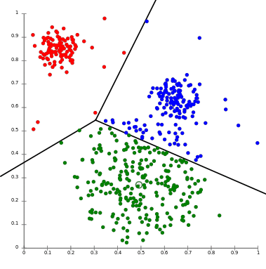
MACHINE LEARNING
K - Means

